Slide 1
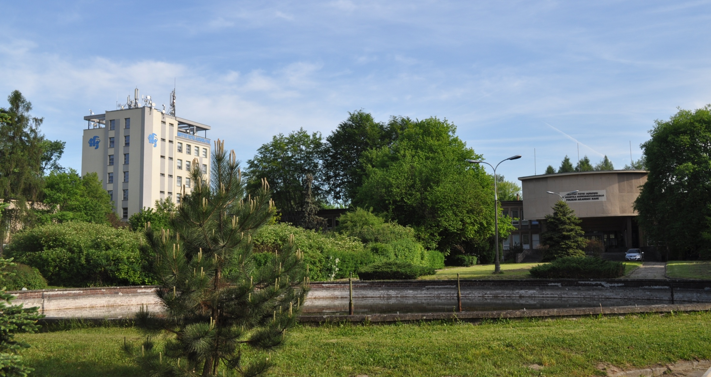
Proton eye raditherapy at the Institute of Nuclear Physics, Krakow, Poland
Barbara Michalec

Slide 2
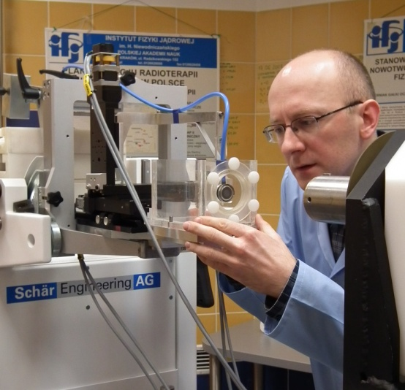
Introduction
Why protons?
Proton eye radiotherapy
Bronowice Cyclotron Center
Summary

Slide 3
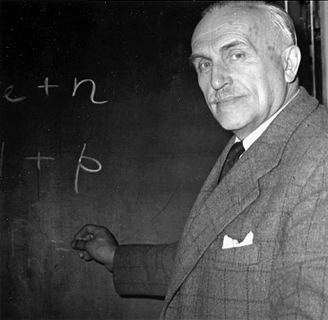

Established in 1955
476 emplyees:
36 professors
  40 assistant professors
5 divisions
Division of Particle and Astroparticle Physcics
Division of Nuclear Physics and Strong Interactions
Division of Condensed Matter
Division of Theretical Physics
Division of Applications of Physics and Iterdisciplinary Research
Bronowice Cyclotron Center
4 laboratories
Engineering workshops
International Ph.D. Studies
Interdisciplinary Doctoral Studies
about 130 students

Slide 4
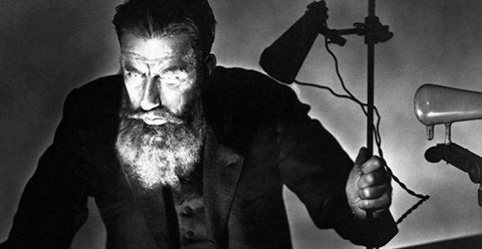
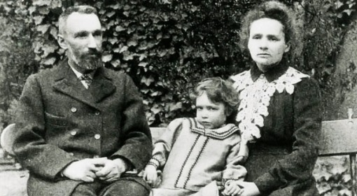
Radiation can cure…
1895 discovery of X rays
1898 skin cancer treatment with X- rays
1899 radium discovery
1900 skin cancer treatment with Ra
1903 gynecological applications

Slide 5
Why protons?
X-rays
8 MV
Tumor
1
Patient body
Dose[a.u]
200 MeV protons
SOBP
200 MeV protns
Bragg curve
5
10
15
20
25
Depth in tissue[cm]

Slide 6
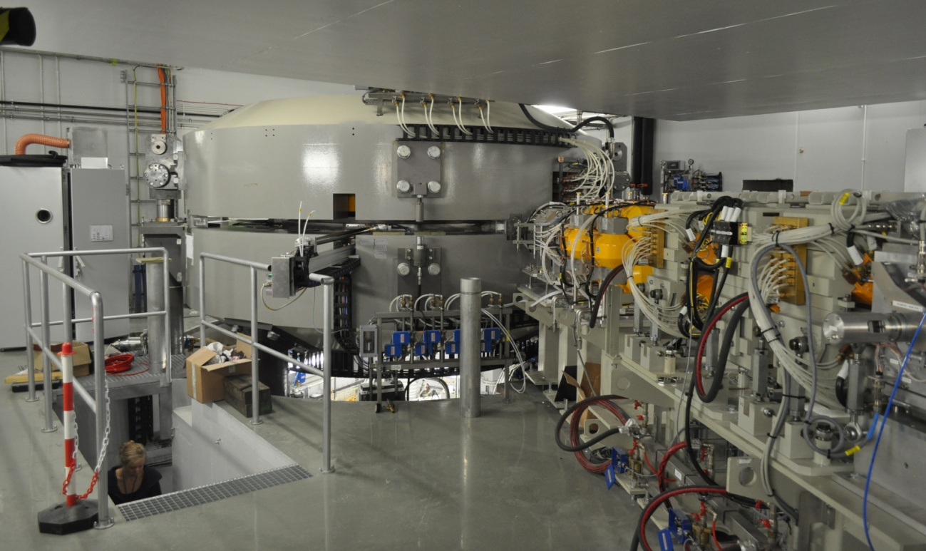
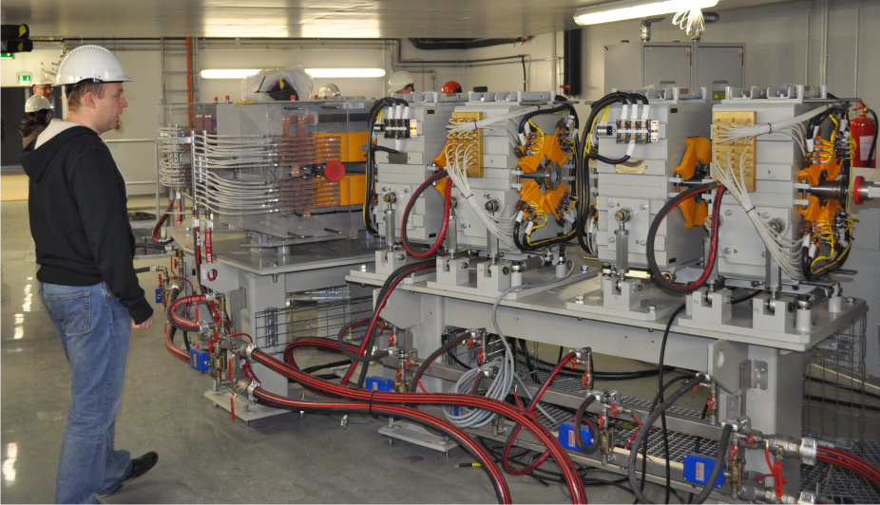
Cyclotrons at IFJ PAN
Isochronous cyclotron
Proteus C-235
for 12th May 2012
P. Olko
J. Swakoń
250 MeV

Slide 7
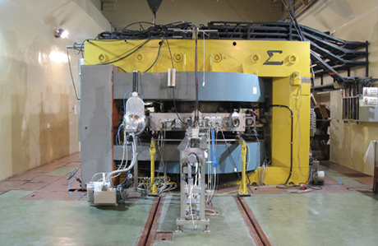
Cyclotrons at IFJ PAN
Isochronous cyclotron AIC-144
(from the 80s)
J. Schwabe
E. Bakewicz
J. Sulikowski
K. Guguła
G. Polok
Particles | Energy [MeV] | Beam current [uA]
protons | 20-60 | 1
deuterons | 15-30 | 20
α particles | 30-60 | 5
60 MeV

Slide 8
History of proton eye radiotherapy at IFJ PAN
2000 - construction of the facility;
04.2004 - 44 MeV proton beam at the facilty;
06.2005 - 55 MeV proton beam at the facilty;
2006-2007 - medical equipment installation;
2008-2009 - facility tests
2010 - „mock therapies”,
consent of the Ethics Committee to conduct the procedure of proton radiotherapy
02.2011 - first patients
11.2012 - proton eye raditherapy is financed by the National Health System
October 2015 – 115 treated patients

Slide 9





Partners
The Department of Opthalmology and Ocular Oncology,
Collegium Medicum, Jagillonian University
University Hospital in Krakow
Center of Oncology,
Maria Sklodowska-Curie Memorial Institute,
Krakow Branch
Faculty of Physics and Applied Computer Science
AGH Univeristy of Science and Technology
National Center for Nuclear Research, Świerk

Slide 10





International Cooperation
Charité, Universitätsmedizin Berlin, Germany
HZB Helmholz Zentrum Berlin, Germany
Clatterbridge Centre for Oncology NHS, Great Britain
Interanational Atomic Energy Agency
Joint Institute for Nuclear Research, Russia
Instituto Nazionaledi Fiscia Nucleare – Laboratori Nazionali del Sud, Catana , Italy

Slide 11
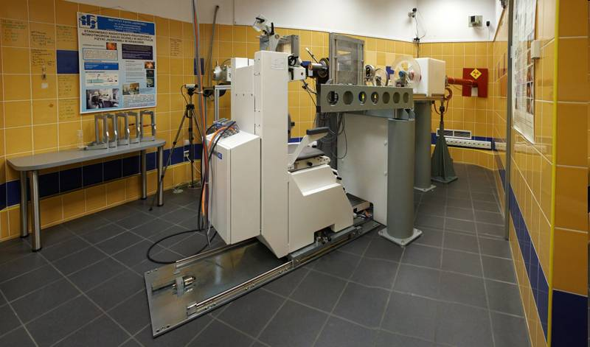
Proton eye radiotherapy facility
Notes:
NAJPIERW STANOWISKO
POTEM PROCEDURA

Slide 12
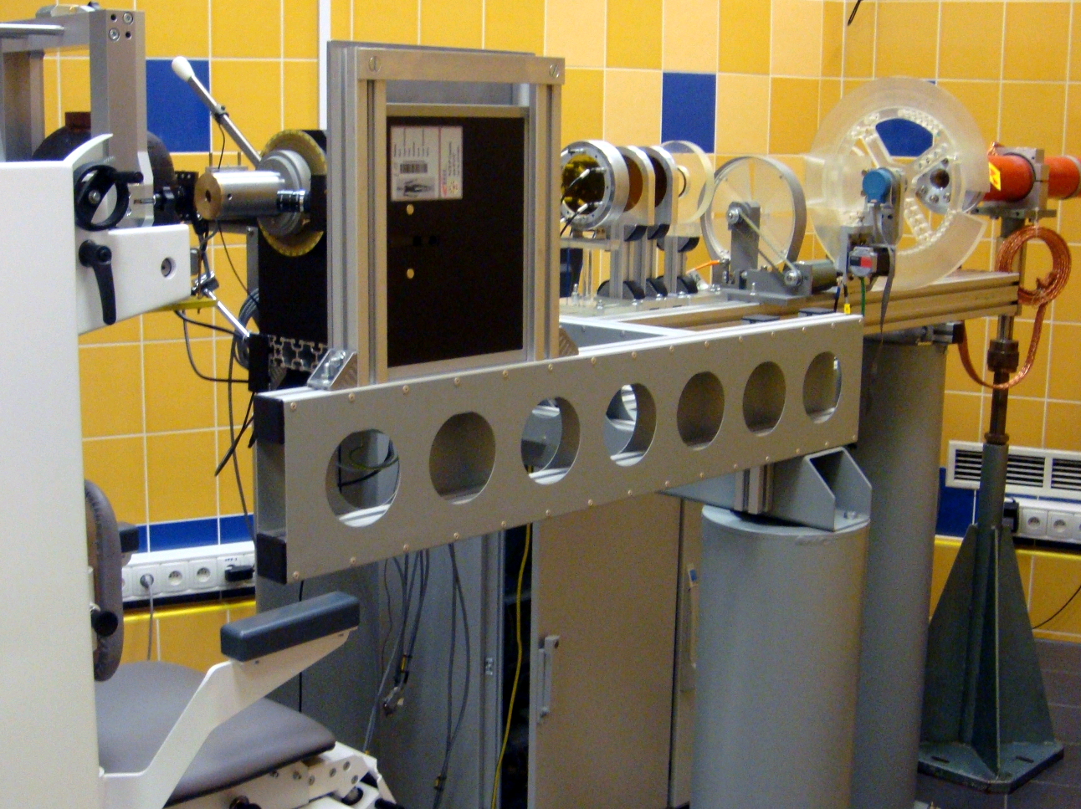
Proton eye radiotherapy facility
CR plate/flatpanel
Beam
Range shifter
Range modulator
Therapeutic chair
Patient collimator
Kontrola wiązki
Beam control elements
Notes:
JONOWÓW
WIĄZKA HORYZONTALNA
FORMOWANIE WIĄZKI
„WSADZENIE” PACJENTA W WIĄZKĘ

Slide 13
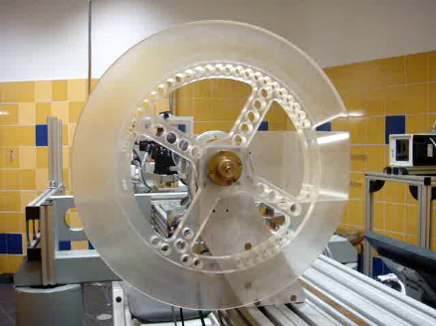
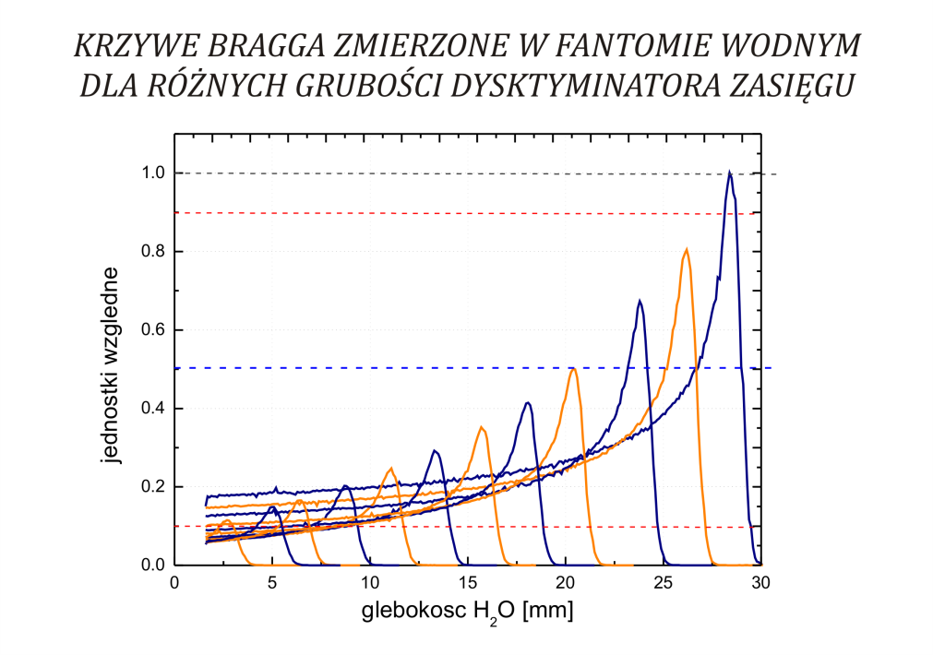
Beam forming system
Range shifter
Bragg curves measured in water phantom
with different thickness of range shifter
a.u.
depth
Range shifter reduces the range of protons,
the thicker wedge the smaller range of protons
Notes:
PROTONY MONOENERGETYCZNE

Slide 14
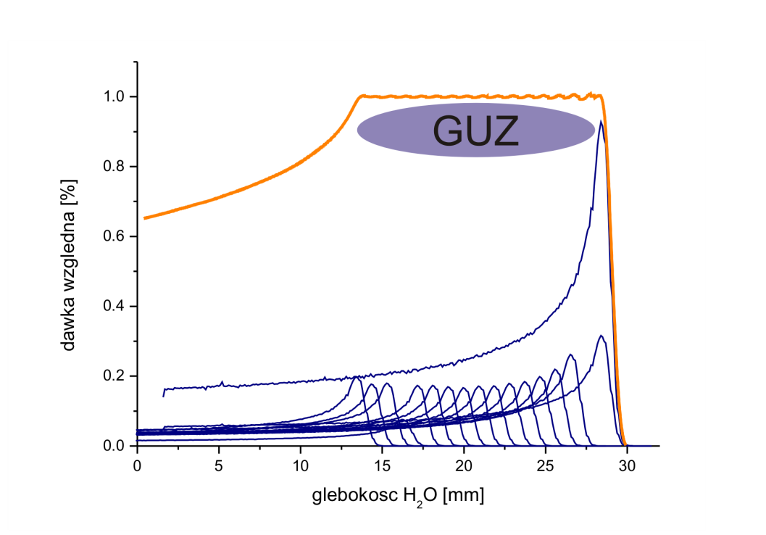
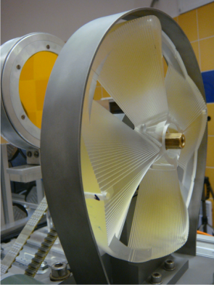
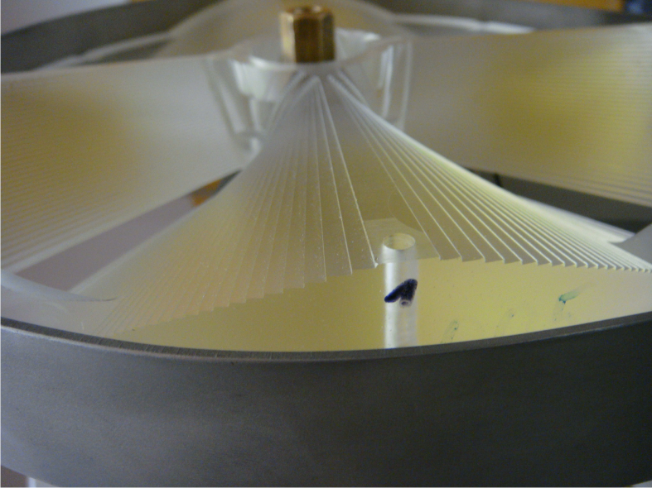
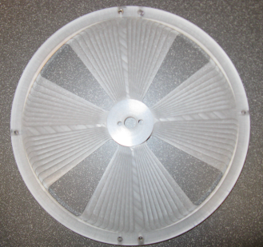
Beam forming system
Range modulator
tumor
Arbitrary dose [%]
depth H₂O [mm]
Range modulator spreads up the Bragg peak in depth.

Slide 15
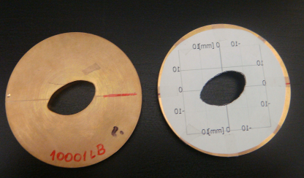
Beam forming system
Patient collimator
Beam control elements
The aperture depends on the tumor shape
Ion chambers

Slide 16
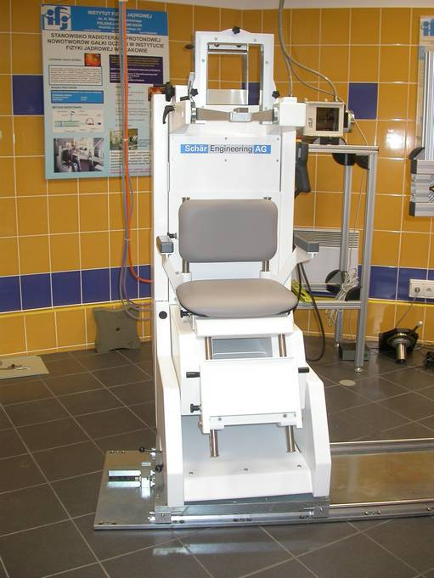
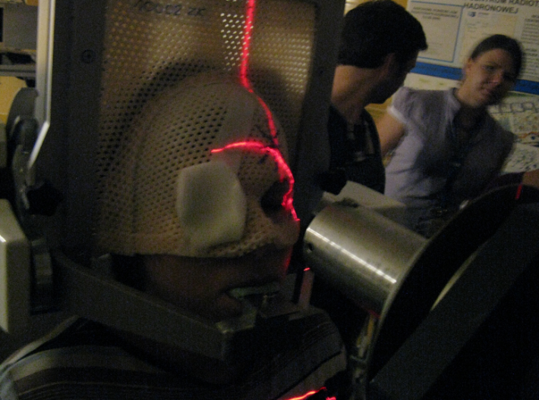
Patient positioning system therapeutic chair, lasers
Therapeutic chair
Schaer Engineering Ltd.

Slide 17
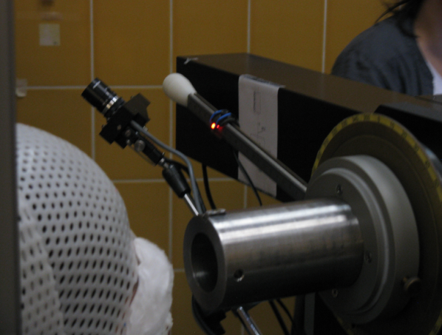
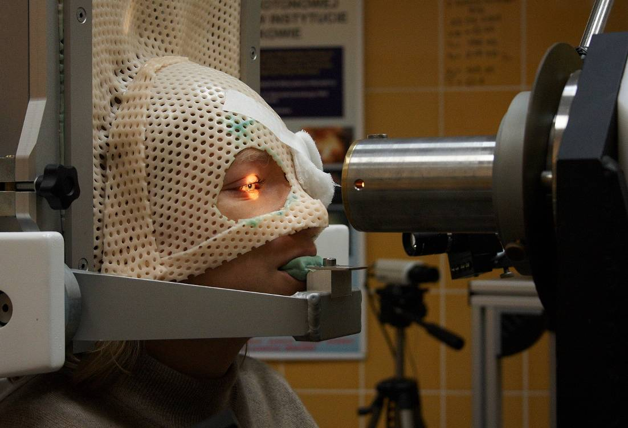
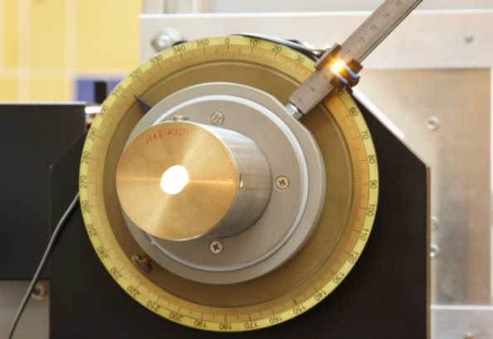
Patient positioning system halogen, LED diode
isocenter
Fixation point
θ
φ

Slide 18
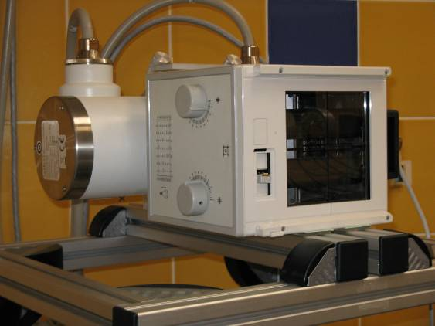
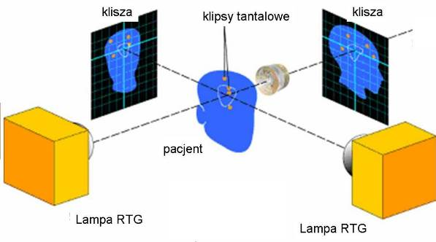
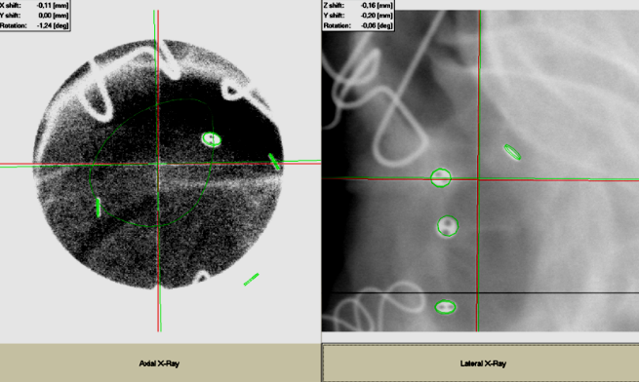
Patient positioning system
X-ray lamps, flatpanels
flatpanel
Tantalum clips
flatpanel
RAD-14 Diamond X-ray tubes
Varian Medical Systems
patient
X-tay tube
X-tay tube
Two orthogonal X-ray pictures
of the patient eye

Slide 19
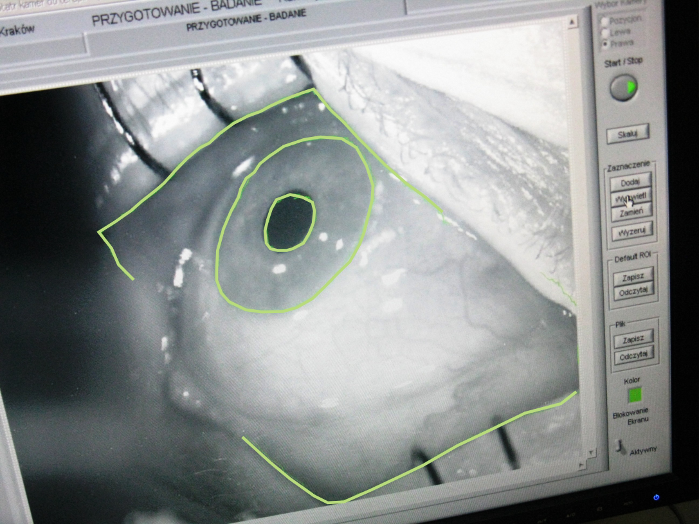
Patien eye monitoring system

Slide 20
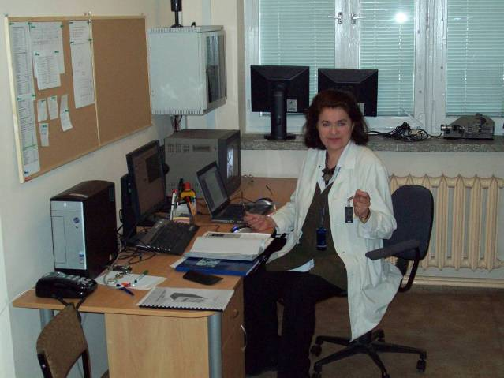
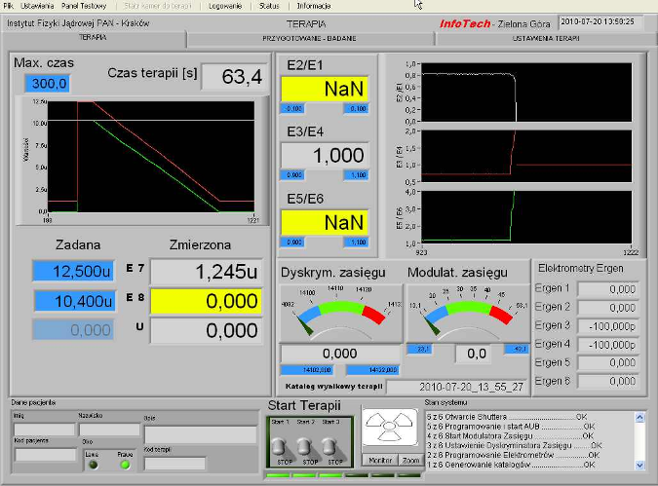
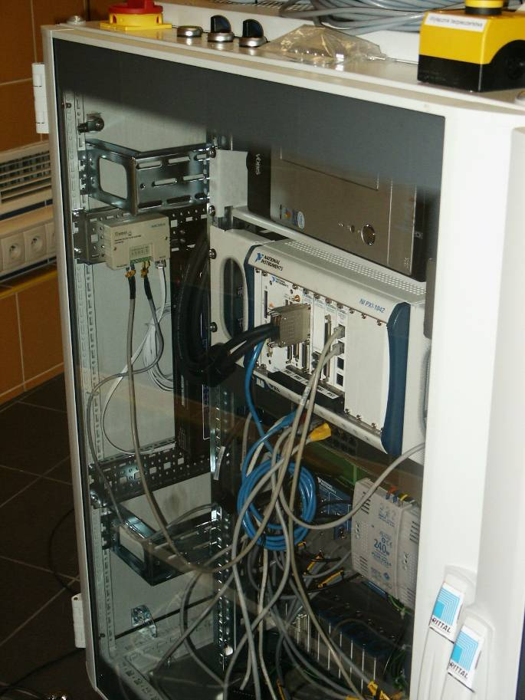
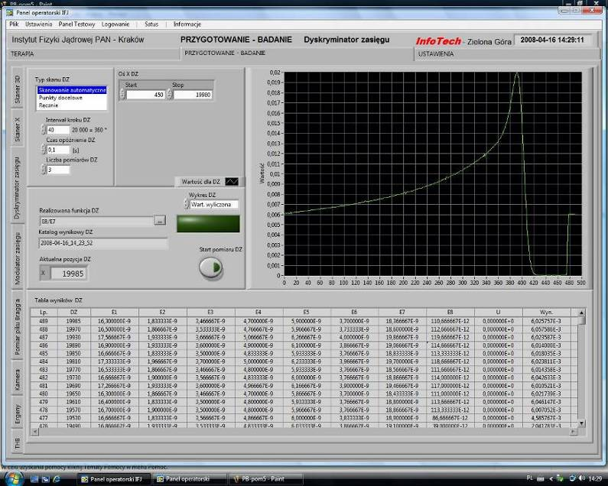
Steering system
Steering room
RT system
RT PXI National Instruments LabView
Widok na konsoli

Slide 21

Proton eye radiotherapy procedure
STEPS
Diagnosis and qualification for treatment
2. Surgical preparation
3. Planning
4. Positioning
5. Irradiation (4 x 15 CGE)

Slide 22
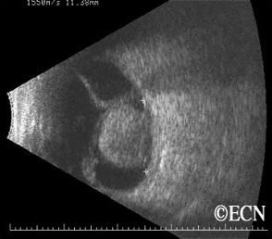
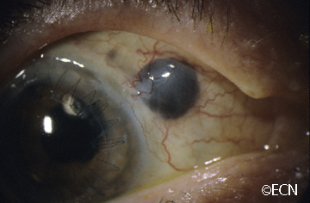
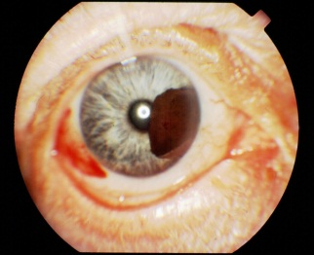
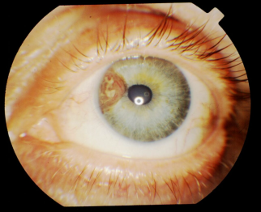
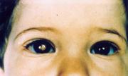
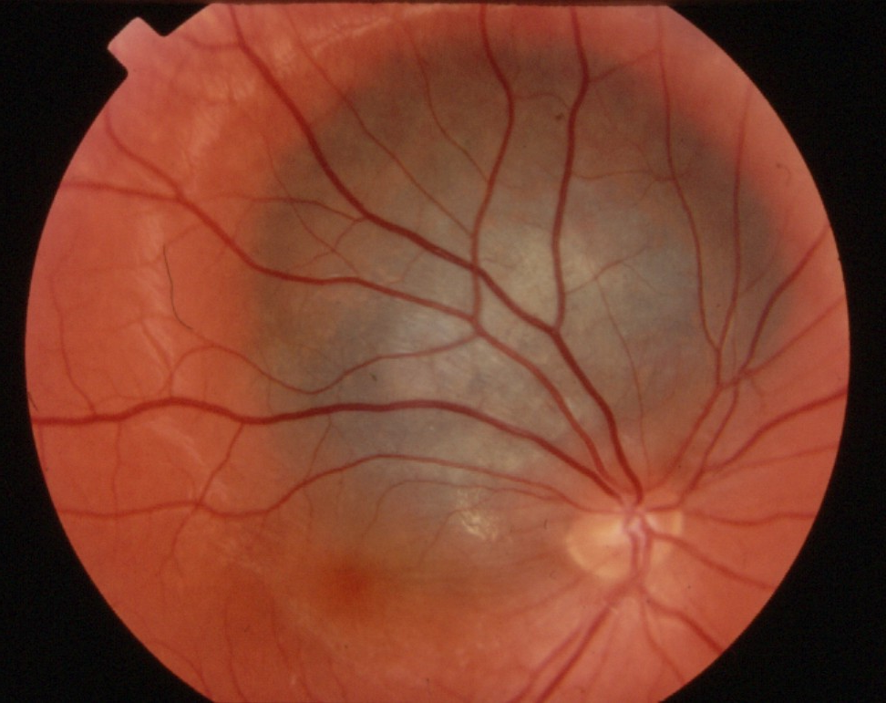
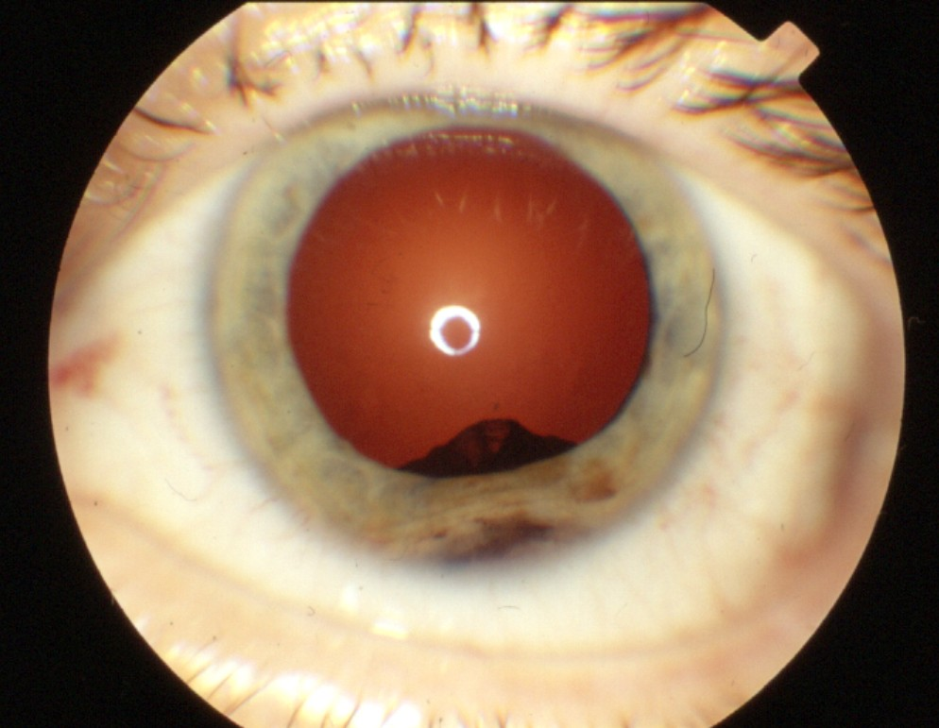
Diagnosis and qualification for treatment
Uveal melanoma - 90%
Ciliary body melanoma - 7%
Iris melanoma - 3%
Retinoblastoma

Slide 23
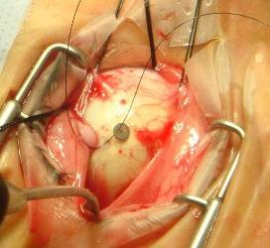
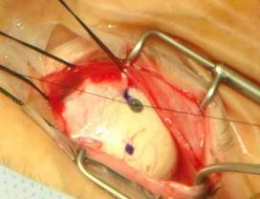
Surgical preparation
Tantalum markers

Slide 24
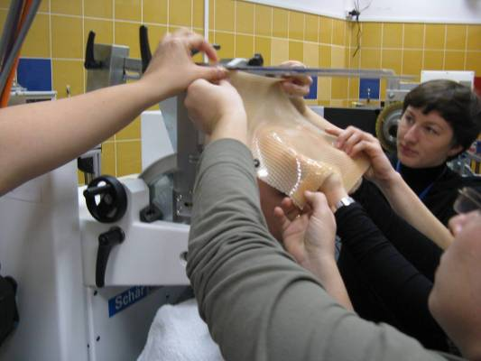
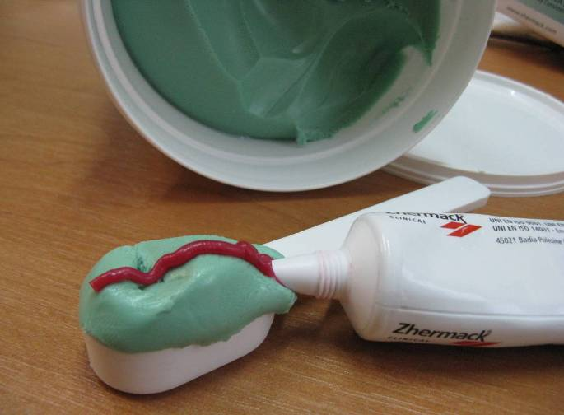
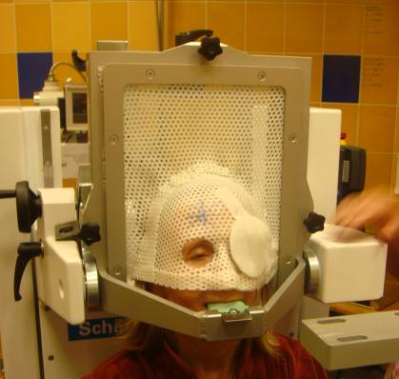
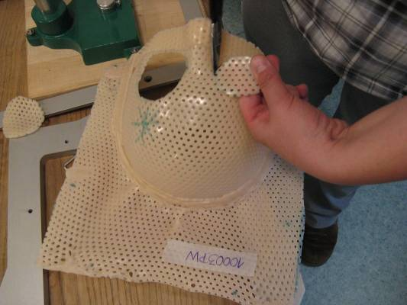
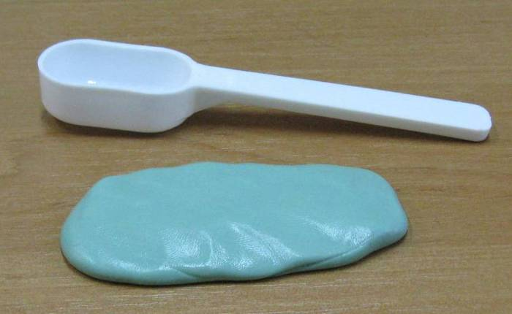
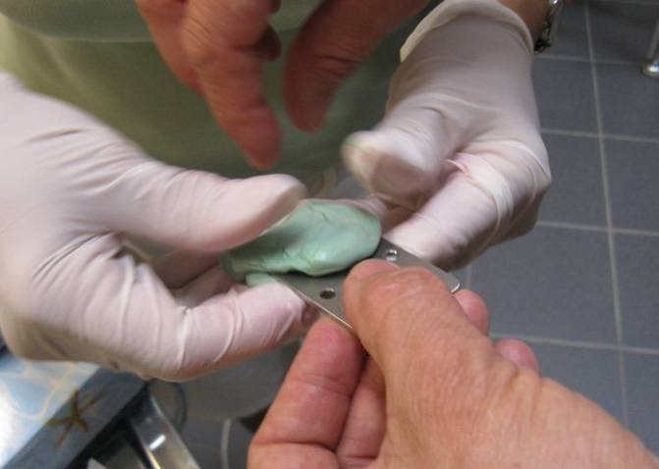
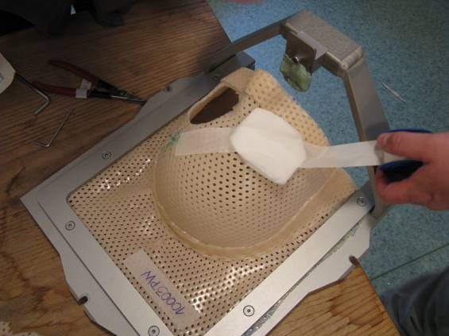
Patient immobilisation

Slide 25
Planning
Dose distribution
Optimal fixation light position
Proton range
Proton modulation
Patient collimator
Eclipse Ocular Proton Planning (EOPP) Varian Medical Systems

Slide 26
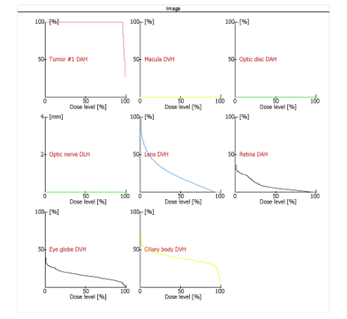

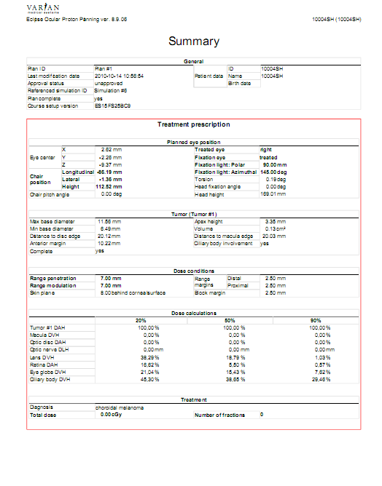
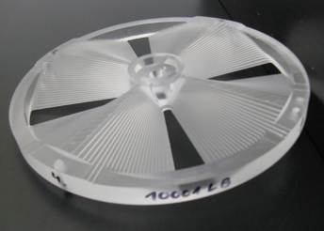

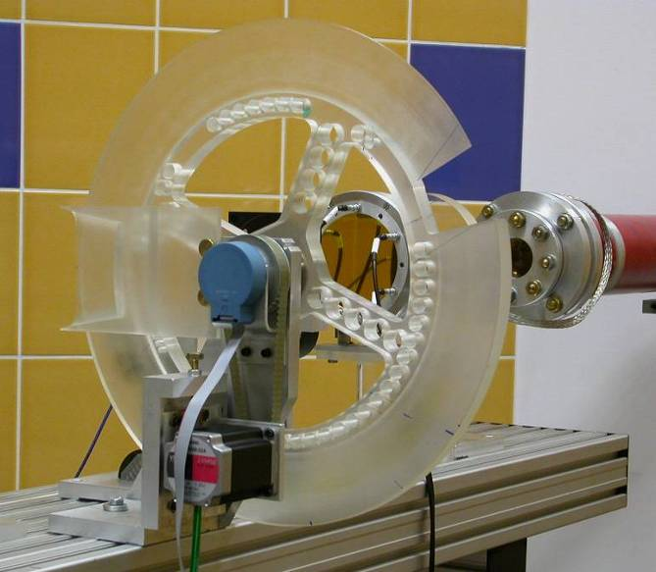
Planning
Kształt apertury zależny jest od kształtu zmiany nowotworowej

Slide 27

Patient positioning

Slide 28

Irradiation
Uveal malanoma 4 x 15,0 CGE = 60 CGE
Iris malanoma 4 x 12,5 CGE = 50 CGE
(CGE = Cobalt Gray Equivalent)
Patient collimator with wedge
Positioning diode

Slide 29

Treatment of the first patients was sucessfully finished.
It was a hard work of more than 50 people – physicists, engeeniers, physicians, technicians…

Slide 30

The National Centre for Hadron Radiotherapy
Bronowice Cyclotron Center (NCRH-CCB)

Slide 31


New proton eye radiotherapy facility – NCRH-CCB
It allows treatment of tumors at any depth
Better patient positioning: isocentric chair, automatic flatpanel
CE Medical

Slide 32


Narodowe Centrum Radioterapii Hadronowej
Faza 2: Centrum Cyklotronowe Bronowice - Stanowisko Gantry
Gantry at NCRH-CCB

Slide 33

Gantry at NCRH-CCB
magnets weightv ca. 10 tons
construction weight ca. 100 ton
Construction diameter 11 meters
Irradiation precision: better than 1 mm

Slide 34

NCRH-CCB – experimental hal
nuclear physics
tests of electronics for space flights
detector testing

Slide 35

NCRH-CCB - radiobiology
Irradiations of hamsters with implanted eye melanoma
Blood irradiations

Slide 36


Radioterapia protonowa z gantry w Europie
Obecnie zaawansowaną radioterapie protonową dysponują:
Niemcy (2 ośrodki)
Szwajcaria (1),
Francja (1)
W budowie: 10 ośrodków
Działające ośrodki:
W budowie:
Paweł Olko IFJ PAN

Slide 37

Proton radiotherapy
Cons:
Proton therapy is more expensive than conventional
There was no evidence of a significant improvement (although there is no such evidence for all currently used radiotherapy techniques)
Pros:
The possibility of dose escalation – local control is more probable
Lower doses to organs at risk (OARs) and healthy tissues - fewer side effects
Less likely hood of secondary, radiation induced tumors (children!)
Less chance of late developmental changes in children
Notes:
37

Slide 38

Summary
Proton therapy is the most advanced radiotherapy technique.
Proton raditherapy offers the most conformal dose distribution .
More than 100 patient with uveal melanoma were treated up till now at IFJ PAN
The National Centre for Hadron Radiotherapy Bronowice Cyclotron Center at IFJ PAN has been operating since January 2013. Patient treatment at the gantry is scheduled to 1.01.2016.

Slide 39


Slide 40

привет!

